Slide 1


enditnow®
EMPHASIS DAY 2022
ABUSE of POWER
Written by Ardis and Dick Stenbakken
PREPARED BY THE
GENERAL CONFERENCE
WOMEN’S MINISTRIES

Slide 2
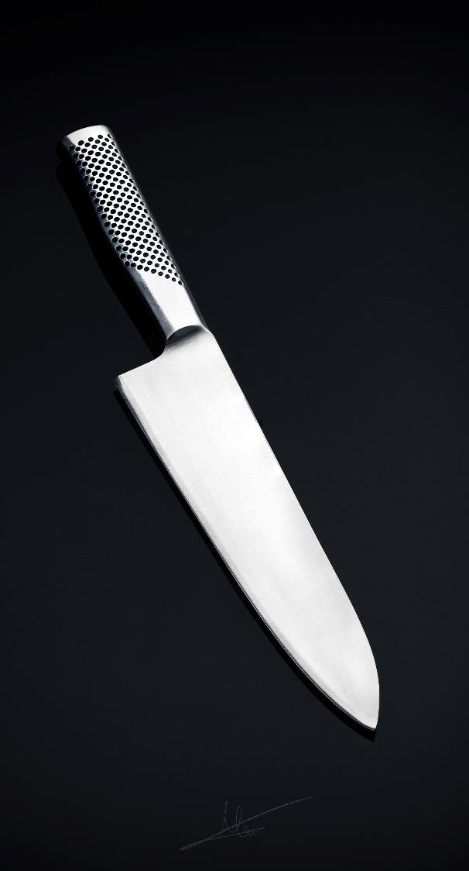
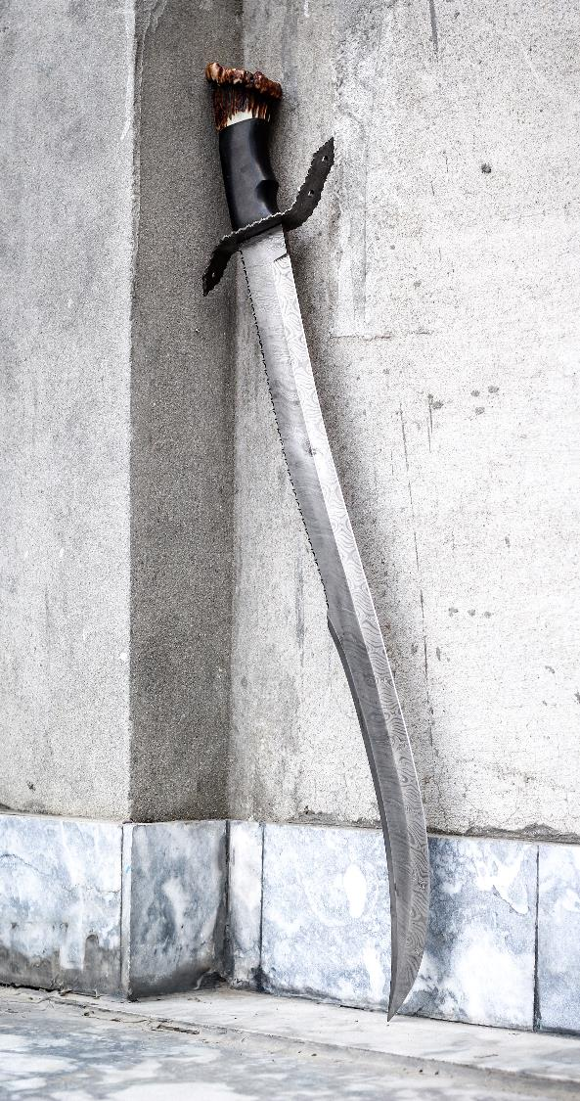
“Is this
good or bad?
Harmful or useful?”

Slide 3
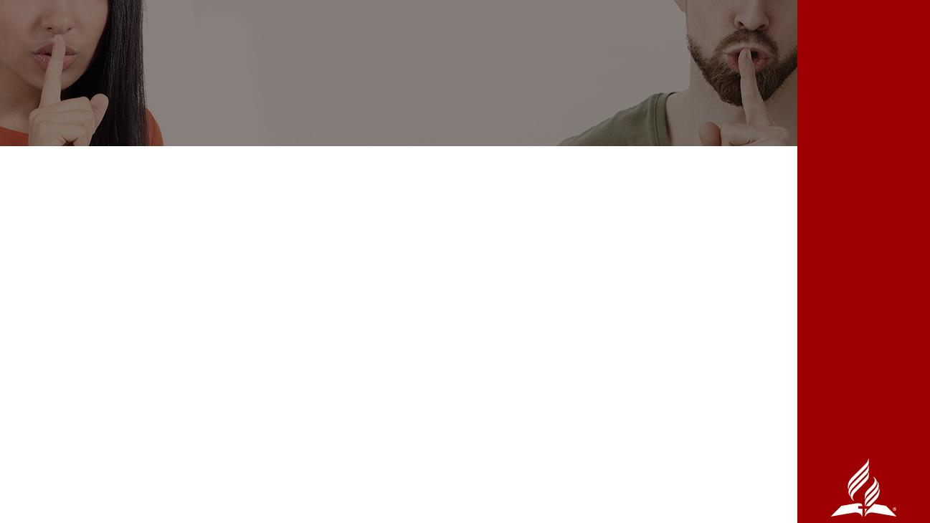
ABUSE OF POWER
IN THE BIBLE
The first and most obvious is that of Lucifer who became known as Satan.
Pharaoh abused his power. (Exodus 10:28)
Eli’s sons. (I Samuel 2:22-25)
King David

Slide 4
POSITIONAL POWER
Lawyer
Teacher
Coach
Caregiver
Doctor
Therapist
Boss/VIP/political
Husbands/wives
Parents
Church Leaders – including youth/Pathfinder leaders, pastors, elders, etc.

Slide 5
OTHER TYPES
OF ABUSE OF POWER
Economic
Influence
Physical
Informational
Psychological
Emotional
Spiritual
Sexual

Slide 6
ABUSE OF POWER
IN THE CHURCH
Around the world there are more and more stories in the press and by word of mouth about the abuse of power.
When boundaries are crossed, someone always gets hurt, and often it is the person who has the power as well as the “victim.” And when it is a church leader not only do the individuals get hurt, but so does the church and the mission of the church.

Slide 7
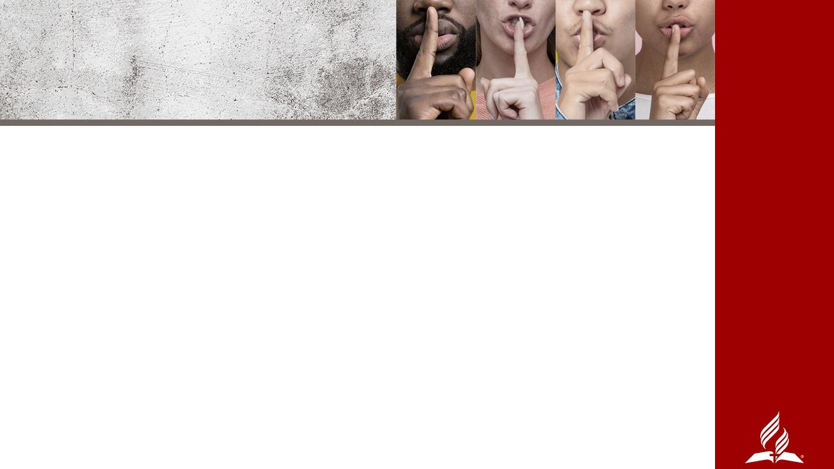
WHAT CAN WE DO?
FIRST, ADMIT THAT WE COULD BE GUILTY OF ABUSING POWER
Accountability - As a pastor, or other spiritual leader or teacher, any person in power, you must recognize that God holds you more accountable and responsible for keeping His standard, not only for your words, but for your whole manner of life.

Slide 8
Mutuality - When we meet on mutual ground, no one overpowering another, we can best work together. If there is inequality at any level, someone is disadvantaged and there is a much greater chance for power to be misused and for abuse to take place.

Slide 9
WHAT CAN WE DO?
Respect - We must respect our own boundaries, our own bodies, and our own power. That means not using them to abuse, nor allowing abuse to happen to us.
Collaboration - In the very beginning, Adam and Eve were both given control. Neither one was to use their power over the other. When we work with, not over others, a much better result occurs.

Slide 10

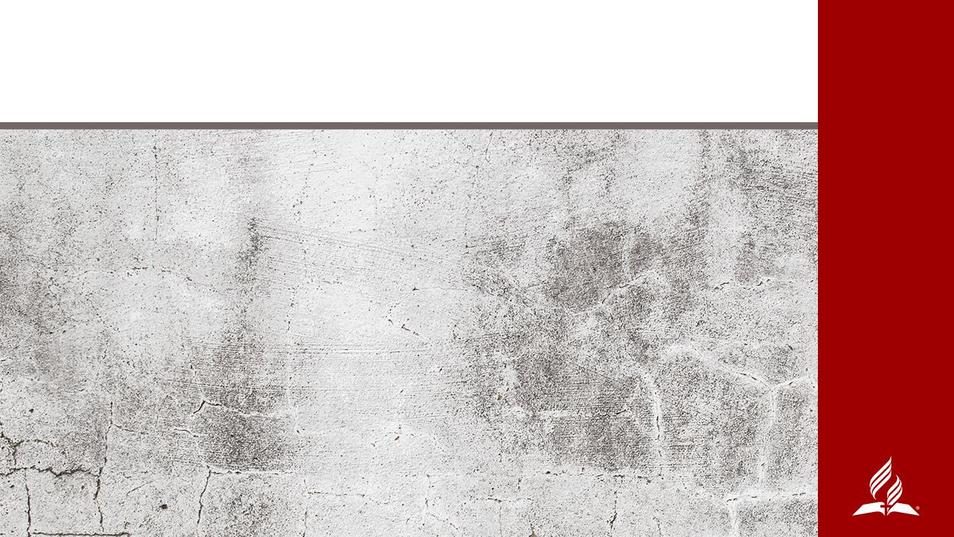
Positive Illustrations
in Ephesians

Slide 11
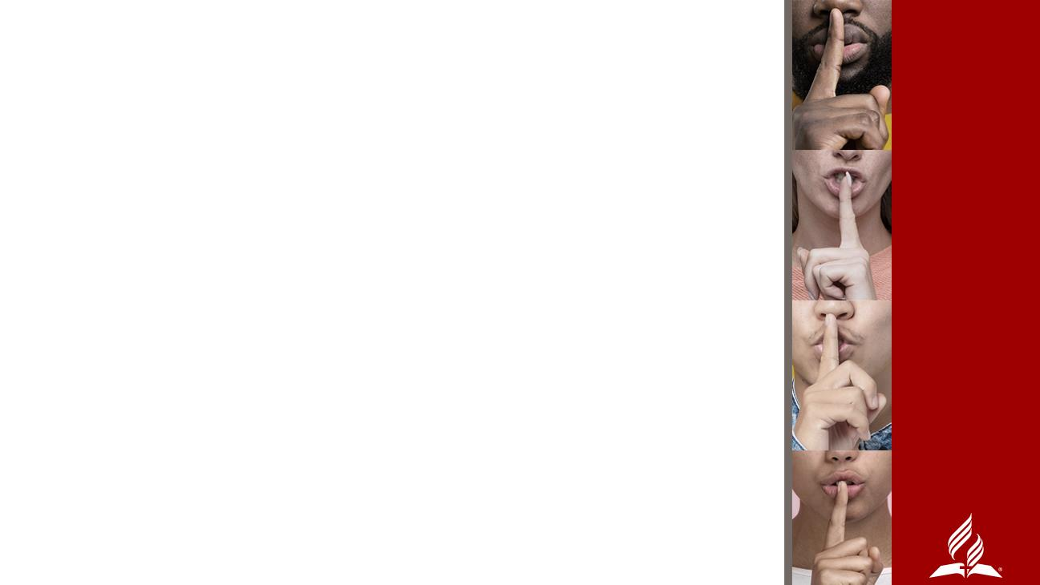
Ephesians. 4:1 and following, Paul wrote that believers are urged to “…live a life worthy of the calling you have received….Be completely humble and gentle; be patient…keep the unity of the Spirit through the bond of peace.”
Paul continues in v. 17-19, warning us of the futility of wrong thinking and action which leads to darkened understanding, separation from the life of God “because of the ignorance that is in them due to the hardening of their hearts.”
Verse 23 invites us to both a new attitude and a new self, “created to be like God in true righteousness and holiness.”

Slide 12
In 4:26 he deals with the reality that we will at times be angry. Yes, we will be angry! Even Jesus got angry (Mark 3:5), but He was never abusive. Anger is just like the sharp instrument demonstrated at the beginning of this sermon.
Paul continues in Ephesians 5:1, we are to imitate God and “live a life of love.”
If we live lives focused on those compelling positive characteristics (accountability, mutuality, respect, and collaboration), we won’t be exasperating, provoking, or “hassling” each other—or even our own children (6:4). Our marital relationships will be built on equity, respect, and mutual submission to each other and especially to God.

Slide 13
A KNIFE—OR ANY SHARP INSTRUMENT—CAN BE USED TO HARM, TO CUT, TO WOUND, TO DEFACE, THAT SAME SHARP INSTRUMENT CAN CREATE SOMETHING BEAUTIFUL.
POWER IS JUST THE SAME. IT CAN BE USED TO HELP CREATE A BEAUTIFUL LIFE SHAPED BY THE HOLY SPIRIT FOR ETERNAL GLORY.

Slide 14
“…live a life worthy of the calling you have received….Be completely humble and gentle; be patient…keep the unity of the Spirit through the bond of peace.”
Ephesians. 4:1

