Slide 1

ABUSE OF POWER
Written by Ardis and Dick Stenbakken
enditnow® EMPHASIS DAY 2022
Prepared by General Conference Women’s Ministries Department

Slide 2
ABUSE OF POWER
There is the problem itself,
what the abuse of power means,
how the problem is dealt with so that the problem does not become bigger,
what to do about the problem,
and how to affect restoration.
Both the victim and the abuser need ministry.

Slide 3
TYPES OF POWER
POSITIONAL
Pastor
Lawyer
Teacher
Coach
Caregiver
Doctor
Therapist
Church leaders
Youth leaders
Pathfinder leaders
Boss
VIP/political
Husbands/wives
Parents

Slide 4
TYPES OF POWER
ECONOMIC
INFLUENCE
PHYSICAL
INFORMATIONAL
PSYCHOLOGICAL and EMOTIONAL
SPIRITUAL
SEXUAL

Slide 5
THE RESPONSIBILITY
OF POWER
The person with the power is also the one who should be held responsible for the situation—not the victim.
Look at the word responsibility—response-ability—the ability to choose your response.
The power differential between the leader and the follower makes the person with the less power vulnerable to exploitation.
—Stephen Covey, The 7 Habits of Highly Effective People

Slide 6
FACTS TO KNOW
Always remember the one in power—power of any type—is the one who is responsible.
We will not be judged by our temptation, but by our response.
Inappropriate sexual contact with a person of the opposite or same sex is sin, even among consenting adults.
If you hear of an abuse case, don’t express disbelief. Abuse happens, even in our church.

Slide 7
FACTS TO KNOW
When any type of abuse occurs, the objective from that point on is restoration.
Sexual violence includes immediate physical and emotional toll, a wide range of chronic physical and mental health problems, and substantial economic costs (medical care, lost work, criminal justice activities).
Sexual harassment and abuse in schools by coaches and teachers is overshadowed by alleged abuse by priests in the Catholic church but is comparable in magnitude.

Slide 8
FACTS TO KNOW
No church is immune.
When sexual misconduct occurs, the church needs to adopt specific procedures.
Every individual involved with children should complete a volunteer application form and undergo appropriate background checks.
If you become aware of abuse by any church leader, a quick response is vital.

Slide 9
FACTS TO KNOW
Regardless of the accusation, the mission of the church must be to protect the abused, to listen to the victim, and to cooperate with the authorities.
If you are a church leader and someone comes to you for counseling, unless what they tell you is illegal, you must keep the confidence. To share what you hear with anyone else in the church can ruin your ministry and their spiritual walk.

Slide 10
FACTS TO KNOW
“Another factor misinterprets gospel mandate to forgive sinners. Thus, pastor sexual misconduct is viewed more as a moral lapse than as a betrayal of professional trust.” — James A. Cress
Responding in the wrong ways makes church leader misconduct in the congregation worse. Know the guidelines.
The mission of the church or institution is damaged by abuse of power. Understanding the negative consequences can motivate the institution to act against leaders abusing power.

Slide 11
STEPS TO AVOID
FALLING INTO SIN
IF YOU ARE THE PERSON IN POWER:
Have an accountability partner.
Leave the office door open and the window uncovered.
Keep your desk between you and your counselee at all times as a physical barrier.
Avoid even casual physical contacts.
Counsel only with couples or with members of the same sex.
Never assume that you are invincible.

Slide 12
THE IMPORTANCE OF
CHURCH DISCIPLINE
Most churches assume that they will never have a case of abuse.
And, therefore have no plans how to take care of the problem.
One of the most common ways of dealing with a problem of abuse of power has been to sweep it under the rug.
But dealing with the abuser is vitally important.

Slide 13

SCRIPTURE CALLS
for discipline
of erring
CHURCH MEMBERS

Slide 14

Matthew 18:15-20 teaches that a sinner is to be confronted, reproved and, if they refuse to repent, excluded from the church.
Acts 5:1-11 illustrates the seriousness of sin within the church, the sensitivity of the Holy Spirit to sin, and the quick judgment of God upon sin.

Slide 15
1 Corinthians 5:1-5 teaches that the church's response to persistent, unrepentant sin is to grieve, deliberate, judge the sin, and exclude the unrepentant member.

Slide 16

1 Thessalonians 5:14 commands us to warn the disobedient and the disorderly.
2 Thessalonians 3:6-15 teaches us to warn the undisciplined brother and withdraw from him.
1 Timothy 5:20 tells us to rebuke persistent sin publicly.

Slide 17

Titus 1:13 says to severely reprove those who teach untruth.
Titus 3:10 commands us to withdraw from a person who causes divisions, but only after adequate warning.
Revelation 2-3 calls churches to repentance and warns of impending discipline if they refuse.

Slide 18
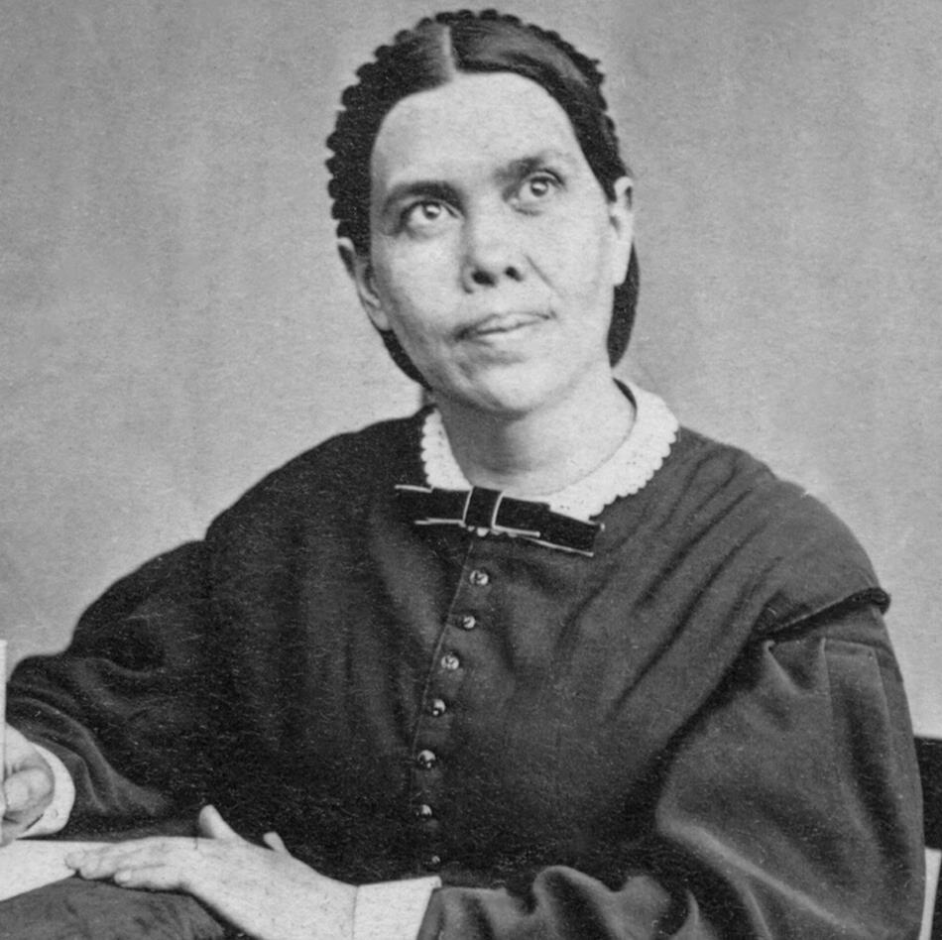
ELLEN G. WHITE ON THE ABUSE OF POWER

Slide 19
“Many who profess to be the ministers of Christ are like the sons of Eli who ministered in the sacred office and took advantage of their office to engage in crime and commit adultery, causing the people to transgress the law of God. A fearful account will such have to render when the cases of all shall pass in review before God, and they be judged according to the deeds done in the body…. Adultery is one of the terrible sins of this age. This sin exists among professed Christians of every class….”
—The Sin of Licentiousness, Testimonies on Sexual Behaviour, Adultery, and Divorce (1989), 99.2.

Slide 20
“If a minister of the gospel does not control his baser passions, if he fails to follow the example of the apostle and so dishonors his profession and faith as to even name the indulgence of sin, our sisters who profess godliness should not for an instant flatter themselves that sin or crime loses its sinfulness in the least because their minister dares to engage in it.
(continued)

Slide 21
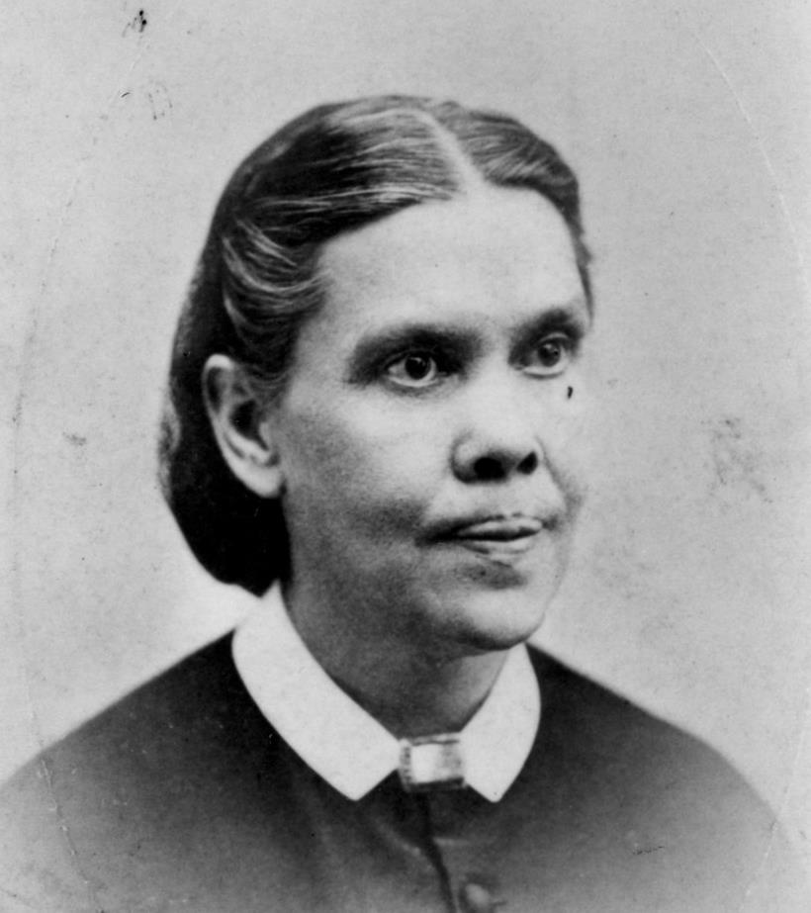
The fact that men who are in responsible places show themselves to be familiar with sin should not lessen the guilt and enormity of the sin in the minds of any. Sin should appear just as sinful, just as abhorrent, as it had been heretofore regarded; and the minds of the pure and elevated should abhor and shun the one who indulges in sin, as they would flee from a serpent whose sting was deadly.”
—Testimonies for the Church, vol. 2, 457.1

Slide 22
“When a man professing to keep God's holy law, and ministering in sacred things, takes advantage of the confidence his position gives him and seeks to indulge his base passions, this fact should of itself be sufficient to enable a woman professing godliness to see that, although his profession is as exalted as the heavens, an impure proposal coming from him is from Satan disguised as an angel of light. I cannot believe that the word of God is abiding in the hearts of those who so readily yield up their innocency and virtue upon the altar of lustful passions.”
—Testimonies for the Church, vol. 2, 457.2

Slide 23

MISUSE AND
ABUSE OF POWER
Chapters 2 through 4 of 1 Samuel

Slide 24
I Samuel 2
2:3: “The Lord is a God who knows and by him deeds are weighed.” (This sets the stage for the warnings to be gained from what follows)
2:9, 10: “It is not by strength that one prevails. Those who oppose the Lord will be shattered. (Again, this is a warning and an introduction to what will be shared)
2:12: “Eli’s sons had no regard for (did not know) the Lord.” (In other words, they were not real. They were fakes pretending to be religious leaders; religious abuse)

Slide 25
I Samuel 2
2:12-16: They intimidated the people and essentially robbed them. They had no regard for the people. (positional and religious abuse)
2:17: The abusive behavior is labeled as sin.
2:22-25: They had no regard for the women who served at the temple. They used their position to be sexually and religiously abusive. (positional, sexual, and religious abuse)

Slide 26
I Samuel 3
3:1: The abusive atmosphere and activity was directly related to a spiritual decline and lack of connection with God. “In those days the word of the Lord was rare; there were not many visions.” (Such is the result of abuse on the entire community, not just on those directly involved)

Slide 27
I Samuel 4
4:10: The losses sustained by the community were great:
  30,000 fell in battle.
  The Ark of God was captured.
  Eli’s two sons and leaders died.
4:18: Eli dies when he hears the negative news.
4:21, 22: The glory departed from the people and nation, because of the multiple abuses of power chronicled in these chapters.

Slide 28

JEREMIAH 7:1-7 REMINDS US . . .

Slide 29
We are to reform/change our ways:
Change our actions
Deal justly
Not oppress the powerless
Not shed innocent blood (the ultimate abuse)
Not to follow other gods (including the drunken god of power and abuse)
THEN, wonderful things happen for the people of God.

Slide 30
WHEN POWER IS ABUSED . . .

Slide 31
God is dishonored, sin is rampant, and the results can be devastating for the entire community, not just on the abused and the abuser.
“The Lord is a God who knows and by him deeds are weighed” (1 Samuel 2:3).
When we violate the boundaries of others, we violate them as well as their boundaries.

Slide 32

“A new commandment I give to you, that you love one another; as I have loved you, that you also love one another.
By this all will know that you are My disciples, if you have love for one another."
—John 13:34, 35, NKJV

