Slide 1
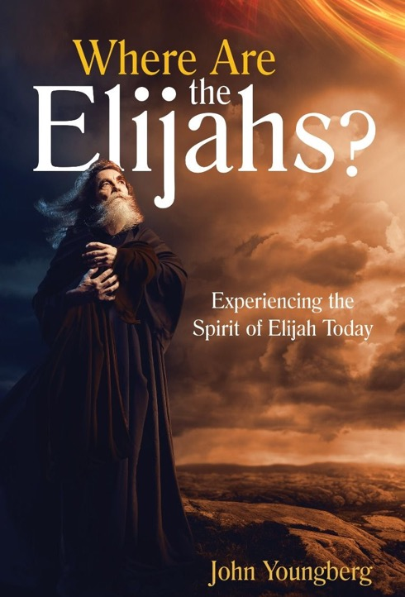

WHERE ARE
THE ELIJAHS?
Experiencing the Spirit of Elijah Today
By John Youngberg
Northern Asia-Pacific Division

Slide 2

CHAPTER 1
THE LAST MESSAGE—THE FIRST MARATHON

Slide 3

REFLECTION
Could I become one of the messengers who deliver the Elijah Message in these times?
How can we do it?

Slide 4

CHAPTER 2: “THEN THE FIRE OF THE LORD FELL”

Slide 5

REFLECTION
Why do you think the Old Testament closes with the promise of the Elijah Message that in the last days God will turn the hearts of parents and children to each other in preparation for the great day of the Lord? (see Malachi 4:5–6).
Why do you think it is that after 430 years of prophetic silence, the New Testament prophecies begin with the angel Gabriel quoting the same Elijah Message promise to Zachariah, the father of John the Baptist? (see Luke 1:14–17).

Slide 6

What did Jesus mean when He said to Peter, James, and John, “Elijah is coming first and will restore ALL things?” (Matthew 17:11, emphasis supplied).
What did Ellen White mean when she asked, “Where are the Elijahs of today?” (Testimonies for the Church, vol. 5, 527).

Slide 7

CHAPTER 3: TISHBE, A BALM FROM GILEAD

Slide 8

REFLECTION
How can I share the love of God with those who have cut loose their hold of hope and love?
What is my responsibility to the members of my own family, especially to the youth and children, as well as to those in my neighborhood and in my circle of acquaintances?

Slide 9

Have I ever experienced separations within my family? In what way do the promises of the Elijah Message for the turning of hearts provide hope for my family?
Have I seen a need for the balm of Gilead? Where? How can I personally bring the balm of Gilead to a world sick with sin?

Slide 10
Why is the balm of Gilead, in the Elijah Message, so valuable to each individual today?

Slide 11

CHAPTER 4: “OH GOD, DO SOMETHING!”—THE CALL

Slide 12

REFLECTION
How can I know that God is calling me? Am I willing to stand up when God calls, regardless of the cost? Can I be an “Elijah”?
Am I willing to put my life on the line in order to share God’s messages? Will God provide me with protection as I work for Him?

Slide 13

REFLECTION
Are the sins of the world today any less horrific than were the child sacrifices in Elijah’s time? How do end–time events impact my convictions?
Why are fervent prayers needed? What does fervent prayer mean to me? Have I experienced God answering my earnest, persevering prayers? For what kind of help should I now be urgently crying out to God?

Slide 14
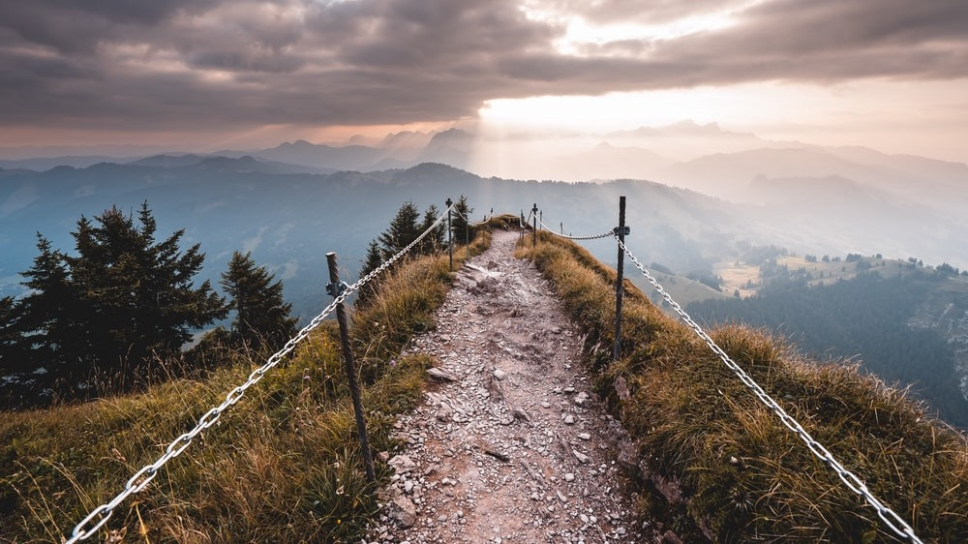
CHAPTER 5: GOD’S LEADING

Slide 15
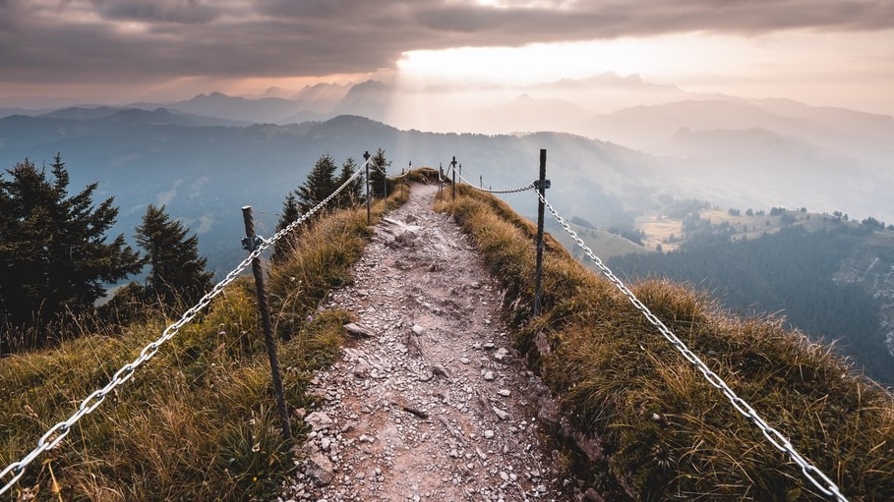
REFLECTION
Have I ever had a “Brook Cherith” in my experience? What are my needs today? Have I had a place where I was far removed from all human support?
Have I trusted God to organize His heavenly forces to send me help in my time of need? How do I know God is listening to me?

Slide 16

How is God shaping me today? Do I have a ministry that is of God? Can people say of me, “Oh, man of God! Oh, woman of God! I know that God is with you and God has sent you?”
Do I know of any dead marriages and dead relationships in my church? How am I going to reach out to those around me needing new life in Jesus?

Slide 17

HAVE I EVER HAD A PRAYER OF THANKS OVER EMPTY PLATES AT AN EMPTY TABLE?

Slide 18
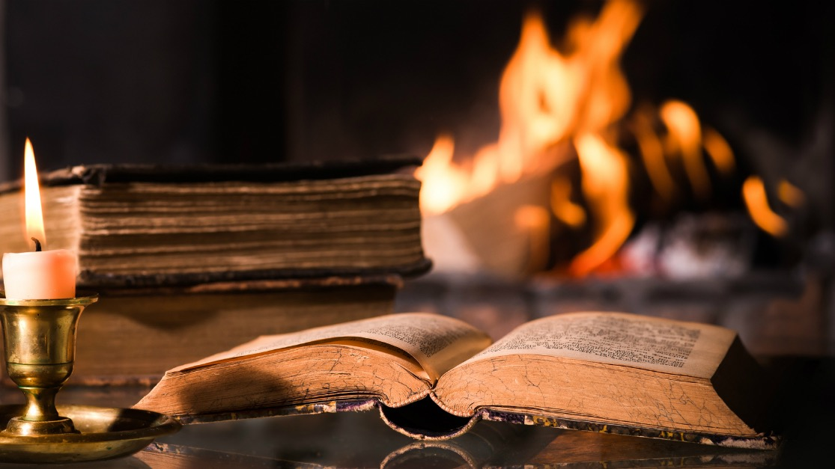
CHAPTER 6: ON CARMEL’S HEIGHTS—PART I

Slide 19

REFLECTION
Do I ever find myself worshiping at the wrong altar? What can I do to change my worship altar to focus on the God of heaven and earth?
What false gods such as money, entertainment, sex, may I be calling on to meet my felt needs? Can these things truly meet my ultimate needs?

Slide 20

How can God help me to experience heart-turning? Are there individuals in my life who need to have heart-turning experiences? Are any altars that I know of broken down and in need of repair?
Do I want a heart-turning kind of worship in my home? Is that the kind of worship that I want to share with the people in my church?

Slide 21
Have I ever experienced a day when I made a choice to follow God’s leading that resulted in my standing completely alone?

Slide 22
CHAPTER 7: ON CARMEL’S HEIGHTS—PART II

Slide 23
REFLECTION
Have I ever wondered why it seemed God was not answering my prayers even when I have prayed the prayer over and over again? Why did it seem God was not listening?
Who in my life may need my persevering, intercessory prayer? In what ways can praying for another person change my own life? Why does God want me to pray for His guidance in my life and in the lives of my family members and friends?

Slide 24
Am I praying for more than just a few scattered drops of the Holy Spirit? Am I praying for an abundant down pouring of the Holy Spirit? Can I ask, believe, and claim the promise in Zechariah 10:1? “Ask the Lord for rain in the time of the latter rain. The Lord will make flashing clouds; He will give them showers of rain.”

Slide 25

CHAPTER 8: RUNNING AWAY FROM GOD
AND CAPTURING A NEW VISION

Slide 26

REFLECTION
Have I ever felt depressed because of my situation? Maybe a Jezebel is after me. Maybe it is a gossipy church member. Perhaps it has become a challenge to handle the kids.
How can I counsel a depressed person—someone who is so depressed that he or she wants to die?

Slide 27

When I have run from God, when I have turned my back on duty, will God still hear me?
Have I ever felt like I was the only one left who was faithful to God?

Slide 28
Do I feel that at some crucial time in my life, God has communicated with me and given me special guidance? If so, share your experience with a friend or acquaintance.

Slide 29
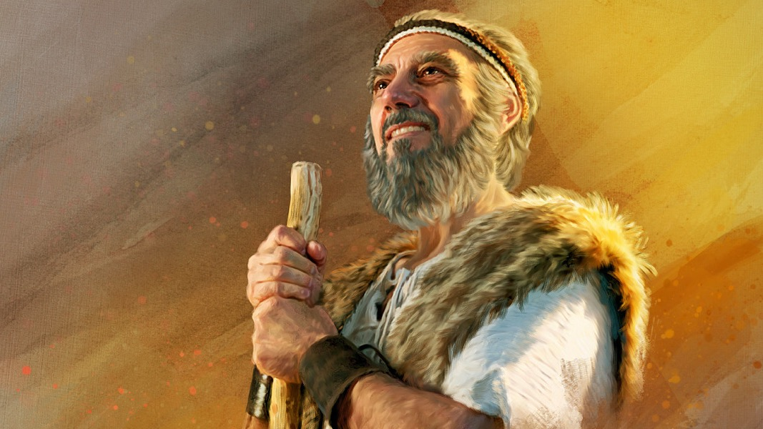
CHAPTER 9: THE SECOND ELIJAH— JOHN THE BAPTIST

Slide 30
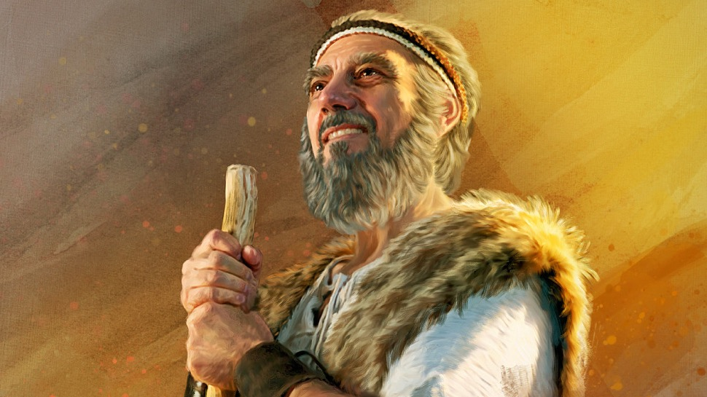
REFLECTION
Am I ready to meet the King of kings and Lord of lords at His second coming?
Am I one of the “stratores,” who is preparing the road for Jesus’ second coming to this earth? Am I a herald of His second coming?

Slide 31
IN WHAT WAYS IS GOD WORKING IN MY LIFE TO MAKE CROOKED PLACES STRAIGHT?

Slide 32

CHAPTER 10: HE RESTORES ALL THINGS— PART I

Slide 33

REFLECTION
Do you think that Joel 2 can be fulfilled in our day? Do you agree that this could happen very soon?
Mothers, grandmothers, where are your jewels today? What are you doing to raise up champions of the truth? Have you asked Jesus to help you shape lives for Him?

Slide 34

Fathers, grandfathers, how are you teaching your children to love Jesus? In what ways are you showing your children the true love of Jesus in making daily decisions?
Children and singles, are you daily asking God how you can serve Him? Can God “who has spoken by the mouth of all His holy prophets, use you as “modern Elijahs” to prepare others for His second coming?

Slide 35

CHAPTER 11: HE RESTORES ALL THINGS—PART II

Slide 36

REFLECTION
When I examine my own life, do I find a ghost town landscape? What can I do to restore “new black soil and trees” back into my life? How can Jesus be part of my reclamation process?
Am I willing to prepare the way of the Lord with my friends and family by sincerely saying, “I am sorry I hurt you. Will you forgive me?”

Slide 37

Where do I find myself in the steps mentioned by Peter in his post-Pentecost sermon [repent, be converted, sins blotted out, receive the times of refreshing that come from the presence of the Lord (outpouring of the Holy Spirit), the restoration of all things]? Am I on the road toward total restoration?
Do I want to be part of the Elijah Message and the restoration of ALL things? How can I help others to be part of a restoration journey?

Slide 38
IT MAY NOT BE LONG UNTIL THIS HAPPENS.
AM I PREPARING? HOW SHALL I PREPARE?

Slide 39

CHAPTER 12: HOW MUCH IS A CHILD WORTH?

Slide 40

REFLECTION
What can we do as parents so that the developing embryo/ child also reflects the image of God?
Did the Baal worshippers have a different idea of a child’s worth than we do today?

Slide 41

In what ways might Seventh-day Adventist Christians be sacrificing children today? Are the gods of personal ambition, materialism, selfish leisure, unwise priorities, and workaholic drives pushing today’s children to destruction?
Have family worship and prayer been replaced by the internet and television? What is stopping parents today from being loving guardians of the children God has given? If we and our home activities were weighed in the balance, would we be found wanting?

Slide 42
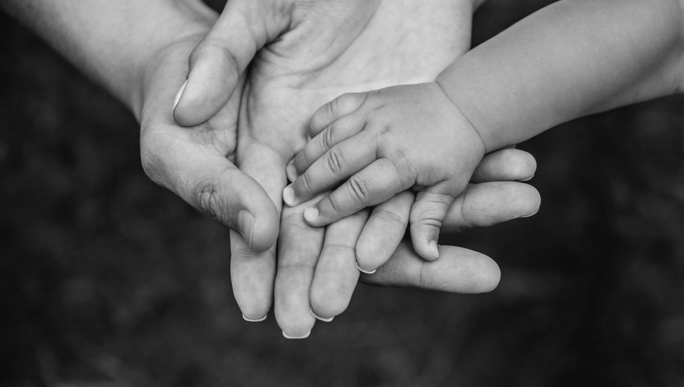
CHAPTER 13: FAMILY COVENANTS

Slide 43
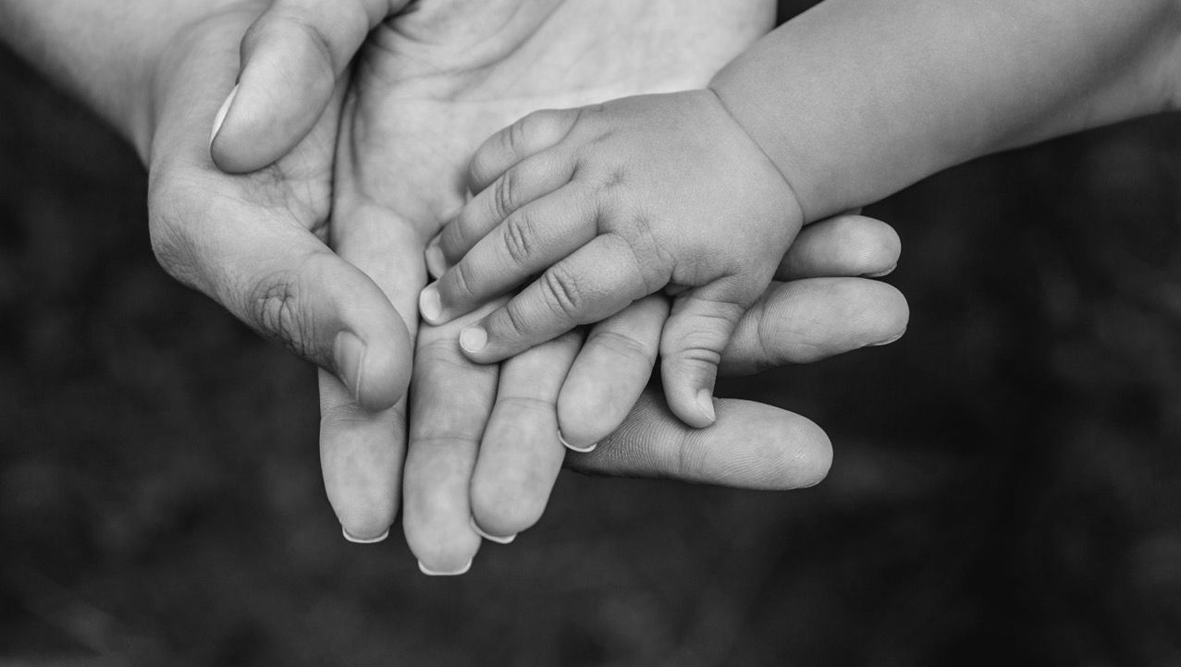
REFLECTION
Do I think God wants to establish a covenant with my family under His guidance? If so, why? In what ways are God’s promises about family heart-turning part of the covenant journey?
What are the relationships between me and my mother and father? Do we hold a mutual family covenant? If not, how can we establish a covenant? Talk it over with members of your family and find an appropriate date to begin.

Slide 44
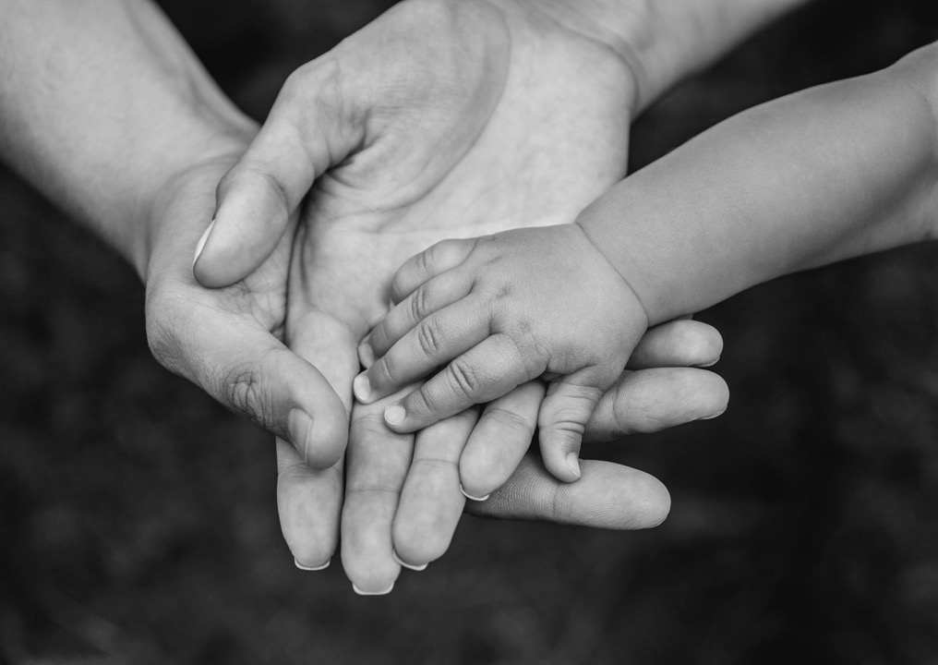
How can I ensure that I keep my covenants with God and with my family?
Do I feel that God has performed great and mighty things for my family across the generations? If so, tell those blessings and share your experience with someone who will be encouraged by hearing your story.

Slide 45

CHAPTER 14: TRANSMITTING OUR HERITAGE—PART I

Slide 46

REFLECTION
Do I model to the coming generation guiding principles by which to live? If so, how? If someone should walk in my footsteps, will it be all right?
Why is the process of mentoring others so important in our journey with Jesus?

Slide 47

Recall a story of a celebration you had with other family members. What made the celebration so special?
What kinds of celebrations can I use to pass on my heritage values to future generations?

Slide 48
CHAPTER 15: TRANSMITTING OUR HERITAGE—PART II

Slide 49

REFLECTION
In what ways am I passing on my heritage, including my religious values, to the next generation?
What good genes have I inherited from my parents? Am I willing to turn OFF bad genes and turn ON good genes by claiming God’s promises and receiving His power in my life?

Slide 50

CHAPTER 16: FUN FAMILY ALTARS

Slide 51

REFLECTION
Can I remember an occasion when my family had an especially fun time? What was the most fun we ever had in a worship setting? Share your memories of the good times and ask other family members to share their memories.
Could I initiate a similar outreach to people in my neighborhood?

Slide 52

HOW WELL ACQUAINTED AM I WITH BIBLE PROMISES? DO I CLAIM BIBLE PROMISES OFTEN IN MY PRAYERS?

Slide 53
CHAPTER 17: GOD CALLS US TO BE “ELIJAHS”

Slide 54
REFLECTION
Am I turning my heart to my children, my spouse, and to others? Have I made a covenant with Jesus to gather a family harvest for Him at His second coming?
Am I among those who are surrendering their hearts to Jesus daily, asking to be filled with the Holy Spirit?

Slide 55
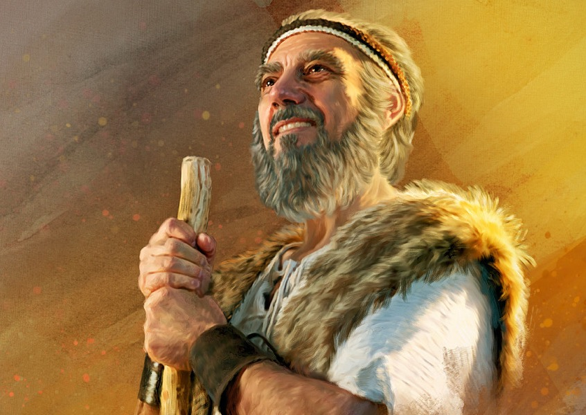
AM I ONE OF THE MEN OR WOMEN BELONGING TO GOD’S HONOR ROLL TODAY?

Slide 56

CHAPTER 18: MIGHTY PREVAILING PRAYER

Slide 57

REFLECTION
Am I tuned in to hear the “delicate whisper”?
Do I desire more power in my prayers? Am I submitting completely to the will of God and humbling myself sufficiently before Him through the Holy Spirit as I make my requests known to Him?

Slide 58
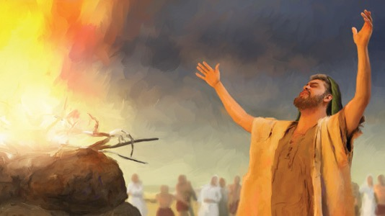
CHAPTER 19: A DOUBLE PORTION OF ELIJAH’S SPIRIT

Slide 59
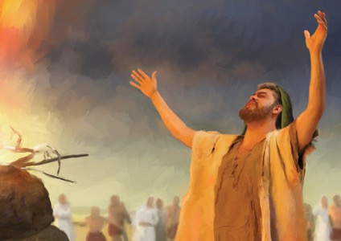
REFLECTION
What do I want to ask God for in these last days of Earth’s history?
Do I want a double portion of the Holy Spirit’s power so that I can be a double blessing to others?

Slide 60
Am I praying the prayers of Elijah? How can I start right now to incorporate the Elijah Message into my life?
Could Elijah’s mantle fall on me to empower me to give the Elijah Message for today?

Slide 61
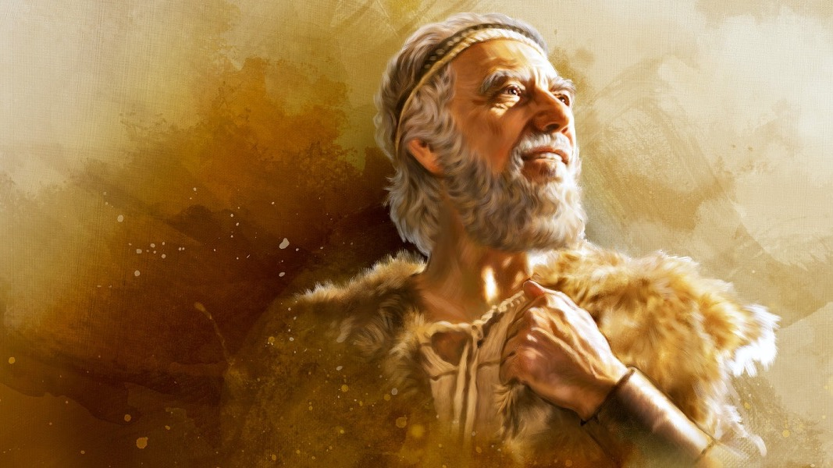
CHAPTER 20: THE ELIJAHS OF TODAY
GIVE GOD’S LAST CALL

Slide 62
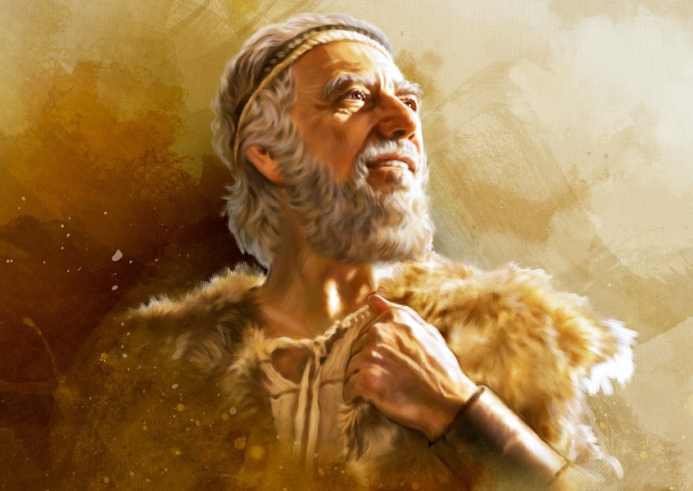
REFLECTION
Am I a modern Elijah? Can I help to determine the eternal destiny of my loved ones and others whose lives I touch?
Will I be one of the redeemed? Will my neighbors be there? Will my loved ones be there?

Slide 63
WHERE ARE
THE ELIJAHS?
Experiencing the Spirit of Elijah Today
By John Youngberg

